Slide 1
Confidence Intervals

Slide 2
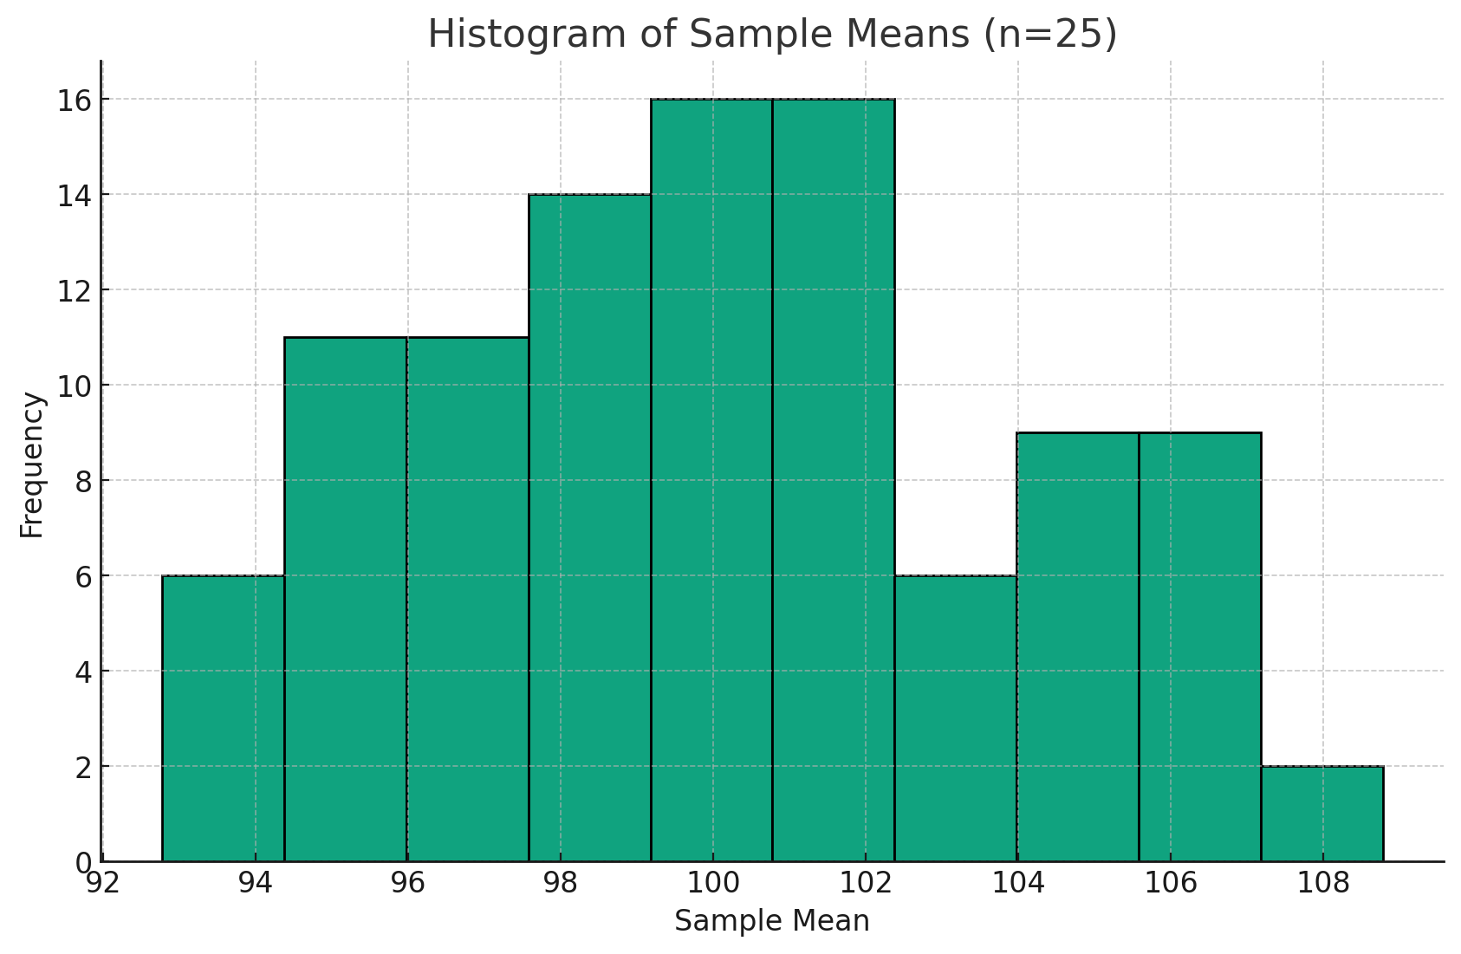
Point Estimates
Point Estimate: A single-number estimate of a population parameter.
Sampling statistics usually differ from the population parameter because of sampling variability / error
We need a way to quantify the uncertainty around a sample estimate
That’s where confidence intervals come in!
population mean = 99.72, 100 samples, max mean = 108.26, min mean = 92.26

Slide 3
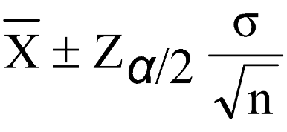

Assumptions and Formula (Z)
Assumptions:
Random sampling
Independent observations
Population standard deviation is known (for Z)
Sample is normally distributed or larger than n = 30
Margin of Error = Z Critical Value * Standard Error
Upper bound = Sample Mean + MOE
Lower bound = Sample Mean - MOE

Slide 4
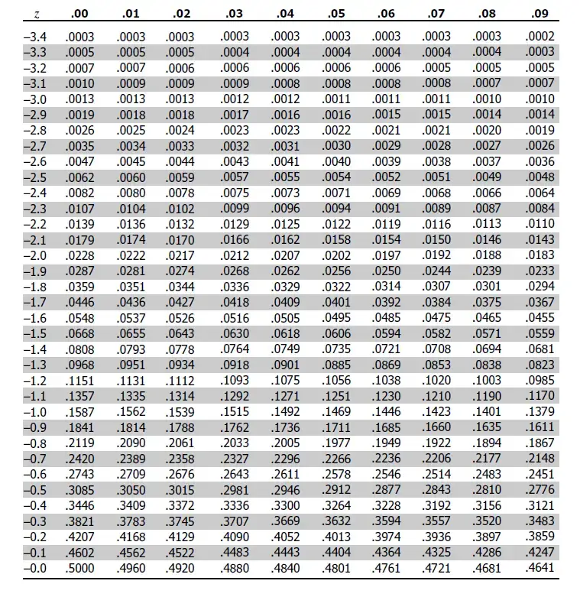
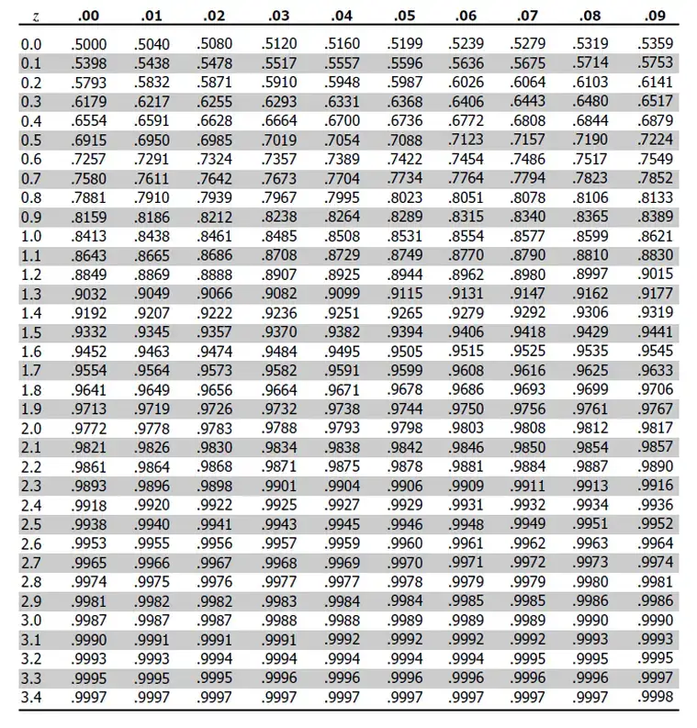

Slide 5
What are Confidence Intervals?
Confidence Interval Interpretation: If we repeatedly took random samples from the same population and built confidence intervals the same way each time, 1 - alpha of those intervals would contain the true population parameter.
A narrower interval indicates a more precise estimate.

Slide 6
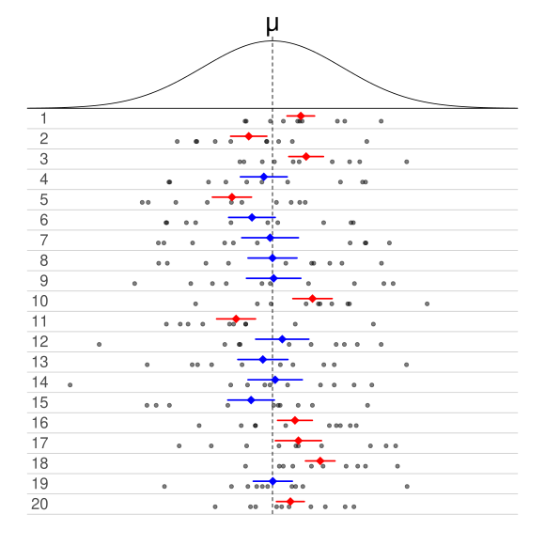
Interpreting Confidence Intervals
Of 20 samples, 20 sample means, and 20 confidence intervals…
None are equal to the actual population mean, as we would expect, due to sampling error
Of the 20 intervals, 10 contain the actual population parameter being estimated
Ergo, this table shows intervals for 50% confidence (if correctly constructed)
Note that 50% refers to the long-run success rate of the method, not the probability for a single finished interval

Slide 7
Interpreting Confidence Intervals
Example:
95% CI for average monthly customer spending [$84, $96]
Interpretation:
We estimate the population mean monthly spend is between $84 and $96

Slide 8
What AREN’T Confidence Intervals
Confidence intervals are constantly misinterpreted.
Incorrect interpretations:
1) There is a 1-Alpha % chance that the true population mean falls within the interval
2) 1-Alpha% of the data fall inside the interval
3) 1-Alpha% of sample means fall inside the interval
4) The interval contains 1-Alpha% of the possible values of the parameter

Slide 9
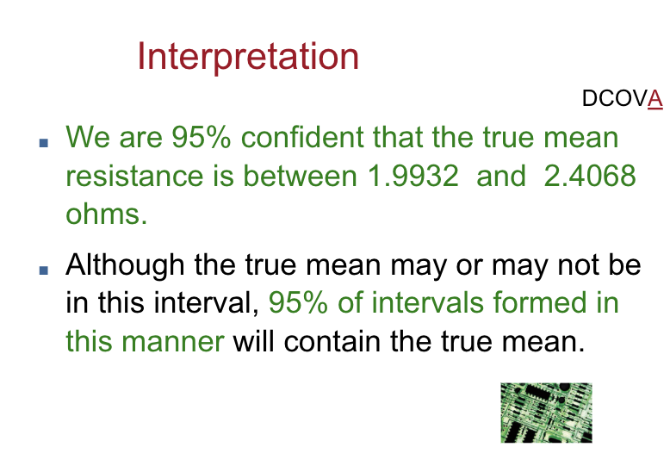
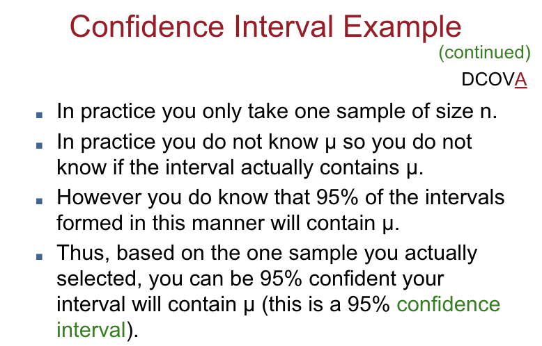
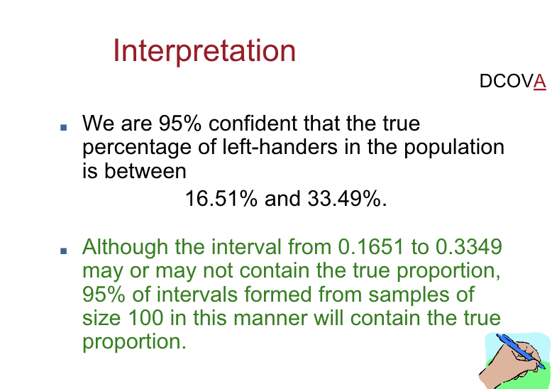

Slide 10
Example
Upper Bound =
100 + 1.96 * (15 / sqrt(81)) =
100 + 1.96 * 1.67 =
100 + 3.27 = 103.27
Lower Bound =
100 - 1.96 * (15 / sqrt(81)) =
100 - 1.96 * 1.67 =
100 - 3.27 = 96.73
Interval =
[96.73, 103.27]
Sample Mean: 100
Sample Size: 81
Population Standard Deviation: 15
Standard Error = 15/sqrt(81) = 1.67
Confidence = 95% / Alpha = 5%
Alpha / 2 = 2.5%
CV from Z Table = 1.96

Slide 11
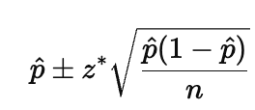
Confidence Intervals for Proportions
Assumptions:
Random Sample
Independent Observations
Large enough sample for normal approximation:
n*p>=10
n(1-p)>=10
60% of customers purchase
P-hat = 0.60
Z for 95% = 1.96
…math…
0.6 + 0.096 = 0.696 = Upper bound
0.6 - 0.096 = 0.504 = Lower bound

Slide 12
Confidence Intervals With Z - Using Excel
Method 1:
Margin of Error =confidence.norm(alpha, population standard deviation, sample size)
Add/subtract MOE to/from the sample mean to get intervals
Method 2:
Z Critical Value = norm.s.inv(1-alpha/2)
Standard Error = stdev.p(x) / sqrt(n)
Margin of Error = CV * SE
Add/subtract MOE to/from the sample mean to get intervals

Slide 13
Confidence Intervals With Z - Using Python
import scipy.stats as stats
import numpy as np
x = [1, 2, 3, 4, 5]
mean_x = np.mean(x)
stdev_x = np.std(x)
n = len(x)
sqrt_n = np.sqrt(n)
cv = stats.norm.ppf(1-(alpha/2))
se = stdev_x / sqrt_n
moe = se * cv
upper = mean_x + moe
lower = mean_x - moe

Slide 14
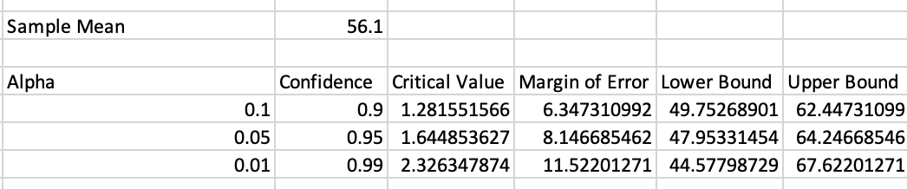
Confidence vs Interval Size
How do intervals relate to confidence?
Higher confidence = More likely to contain the population parameter
More likely to contain the population parameter = Wider!
Higher confidence -> Larger critical value -> Larger margin of error -> Wider interval

Slide 15
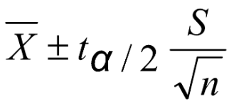
What if you don’t know the population standard deviation?
You almost never will!
In this case use the T-Distribution instead of Z-Distribution
Use sample standard deviation instead of population standard deviation
The t distribution is determined by degrees of freedom. The critical value chosen depends on alpha and whether the interval is one or two sided
DOF = n - 1
Tails = 2
Fun Fact: As sample size increases, T approaches the normal distribution

Slide 16
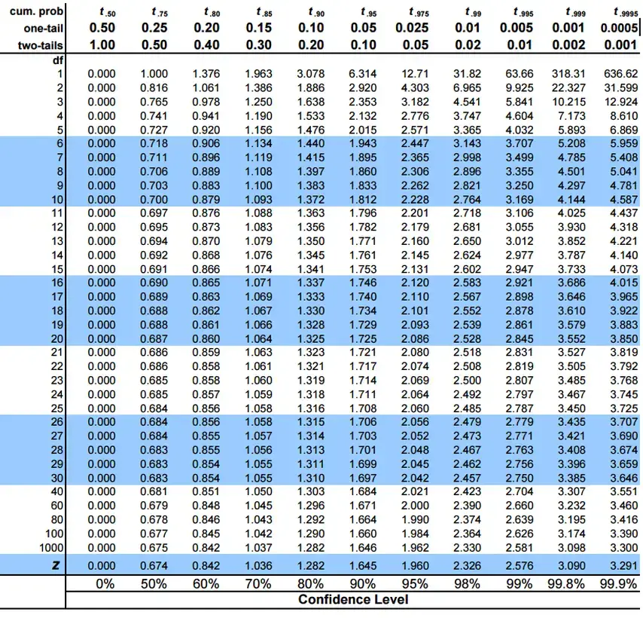

Slide 17
Example
Upper Bound =
50 + 2.064 * 3 / 5
MOE = 2.064 * 0.6 = 1.23
50 + 1.23 = 51.23
Lower Bound =
50 - 1.23 = 48.77
Interval =
[48.77, 51.23]
Sample Mean: 50
Sample Size: 25
Sample Standard Deviation: 3
SE: 3 / sqrt(25) = 0.6
Confidence = 95% / Alpha = 5%
Alpha / 2 = 2.5%
CV from T Table = 2.064

Slide 18
Confidence Intervals With T - Using Excel
Method 2:
Critical Value = t.inv.2t(alpha, n-1)
Standard Error = stdev.s(x) / sqrt(n)
Margin of Error = CV * SE
Add/subtract MOE to/from the sample mean to get intervals
Method 1:
MOE =confidence.t(alpha, sample standard deviation, sample size)
Add/subtract MOE to/from the sample mean to get intervals

Slide 19
Confidence Intervals With T - Using Python
Python w/ Scipy
import scipy.stats as stats
import numpy as np
x = [1, 2, 3, 4, 5]
mean_x = np.mean(x)
stdev_x = np.std(x, ddof=1)
n = len(x)
sqrt_n = np.sqrt(n)
cv = stats.t.ppf(1-(0.05/2), df=n-1)
se = stdev_x / sqrt_n
moe = se * cv
upper = mean_x + moe
lower = mean_x - moe

Slide 20
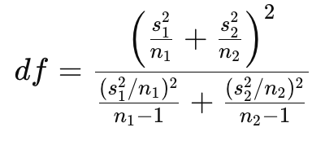
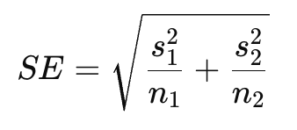
Difference in Means
CI = (Mean 1 - Mean 2) +/- CV * SE
Point estimate: Mean 1 - Mean 2
T Stat = (Mean 1 - Mean 2) / SE
DF = Welch’s DF formula
Example:
Mean: 84, SD 10, n: 40
Mean 79, SD: 12, n: 35
Difference = 5
Example:
SE: …math… 2.57
DF = 66.47 = 66
CV = 1.997
MOE = 1.997 * 2.57 = 5.14
Interval = 5 +/- 5.14
[-0.14, 10.14]
Because 0 is in the interval, it's possible the true difference is zero.
Note: Uses T dist and has same assumptions as T intervals

Slide 21
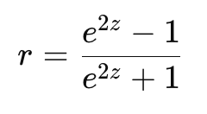
Confidence Interval for Correlation
Since sampling distribution for correlation coefficient is not symmetric, we must transform using Fisher z transformation
z = ½*ln((1+r)/(1-r))
se = 1 / (sqrt(n-3))
cv = Z for given level of confidence
Confidence interval (in Z space) = z+/- CV*SE
Convert each endpoint back into correlation using:
r = 0.60, n = 50
cv for 95% = 1.96
z = ½*ln((1 + .6)/(1 - .6)) = 0.693
se = 1 /(sqrt(50) -3) = 0.146
ci = 0.693 +/- 1.96*0.146 = [0.407, 0.979]
But this needs to be converted back to correlation
ci = [0.39, 0.75]

Slide 22
Understanding Polling
Candidate A is at 51%
Candidate B is at 49%
Margin of Error is +/- 3%
Who is winning?
Too close to call.
Observed difference isn’t statistically significant!

Slide 23
How To Build The Right Confidence Interval
Identify parameter (mean or proportion)
Check assumptions (random, independent, normal / large n)
Decide Z or T (Z if population stdev known)
Compute standard error
Find critical value
Compute margin of error
Build interval
Interpret

Slide 24
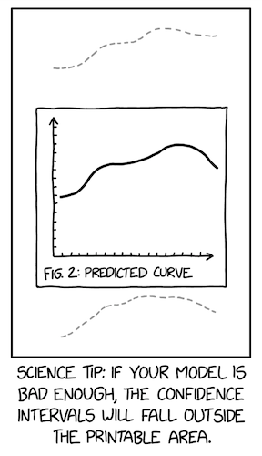

Slide 25
Necessary Sample Size

Slide 26
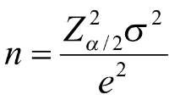
Necessary Sample Size For Estimating A Mean
For a confidence level and an acceptable margin of error, how large must our sample be?
e = desired margin of error (added and subtracted to get confidence intervals)
n = necessary sample size

Slide 27
Necessary Sample Size Example
Standard Deviation = 45
If you wanted to know the mean +/-5 at the 90% confidence level, you’d need…
(1.645^2 * 45^2) / 5^2 = 219.19
Round up to 220
n must be at least 220

